Slide 1
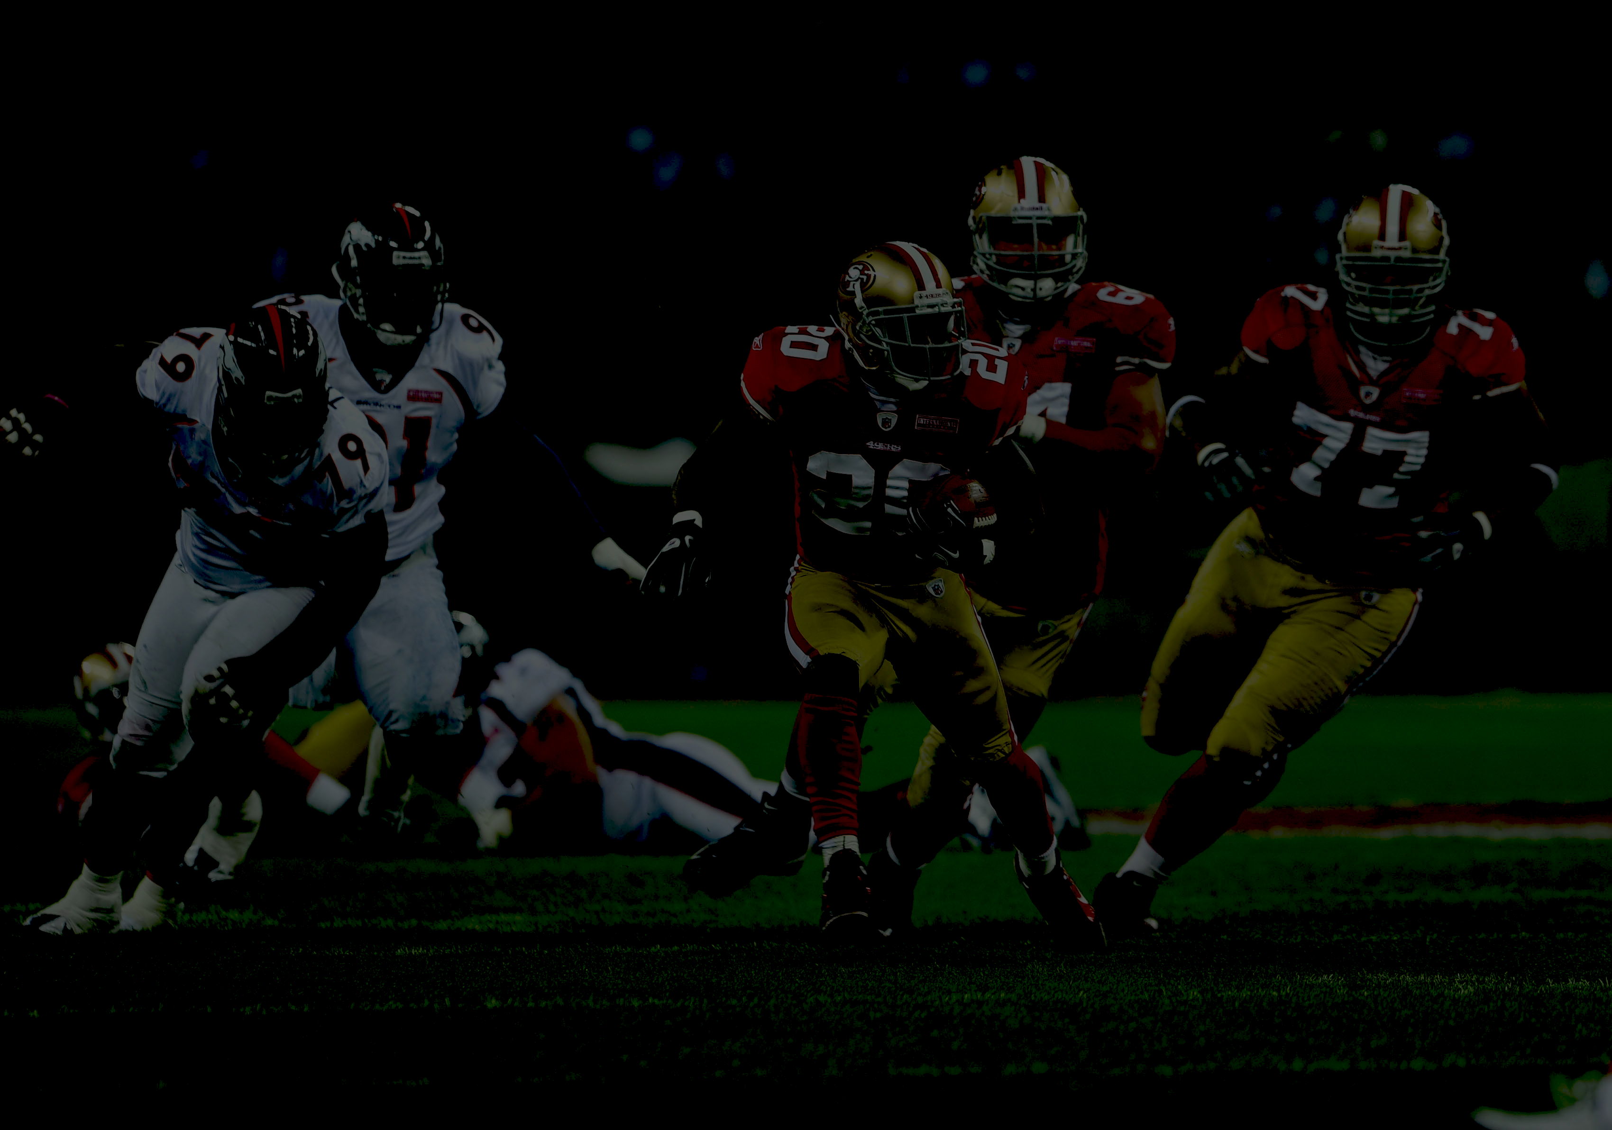
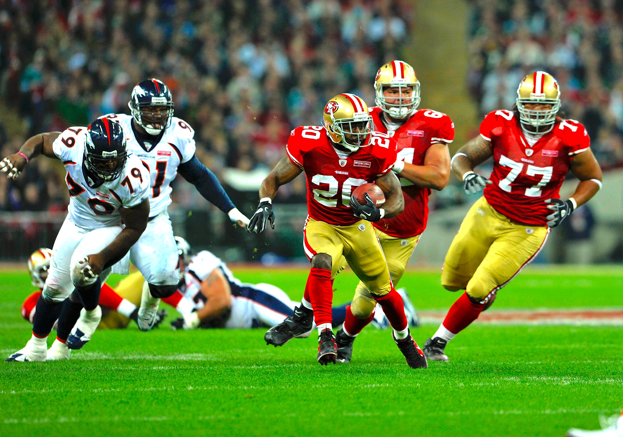

Scraping the web for all NFL pass, run & field goal data
1998 - Present
Alex, Ryan, Felipe
× 2

Slide 2
OBJECTIVE
Scrape NFL play data from multiple sources
Combine in relational database for analysis
Analyse passes, runs, field goal information
Look for trends in types of play / pass over time

Slide 3
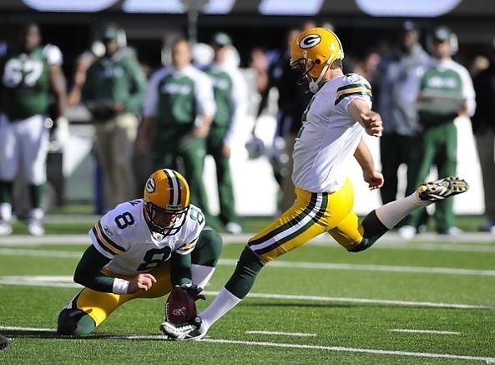
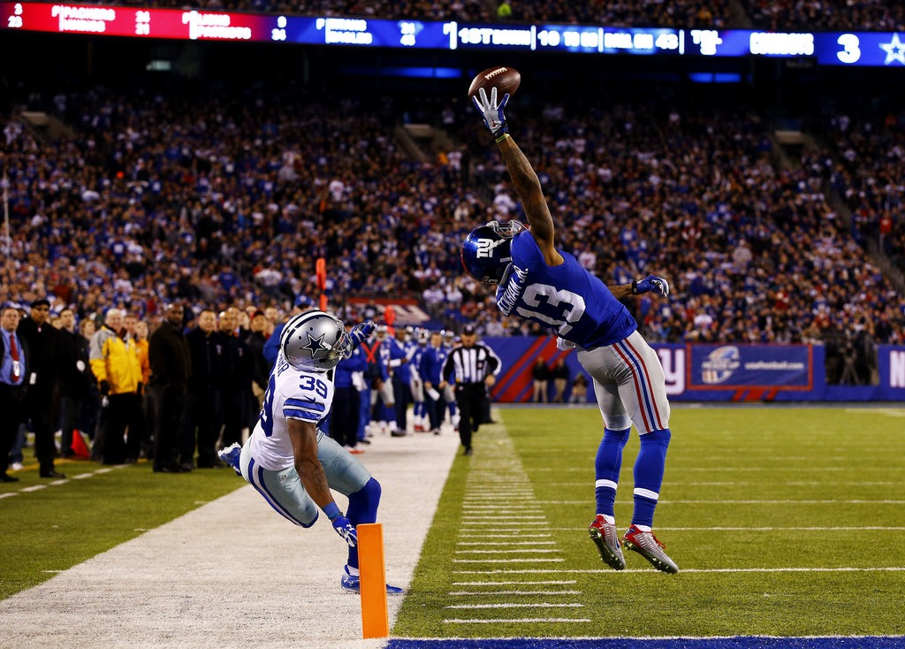
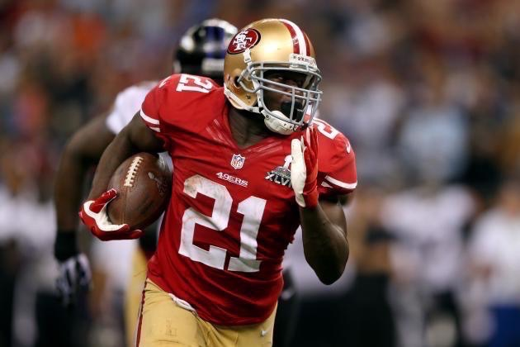
DATA
Field Goals
Kicker
Distance
Successful?
Pass play
Passer
Receiver
Successful?
Distance
run play
Runner
Tackler
Distance

Slide 4
Tools
MacBooks
WGET
Python & BeautifulSoup
Amazon Web Services postgreSQL server
R & ggplot2

Slide 5
Acquisition
Scrape information plays from pro-football-reference.com
290,945 passes
241,372 runs
4942 field goals
5773 players
4312 games
Pull date, time, score, venue information from nfl.com

Slide 6
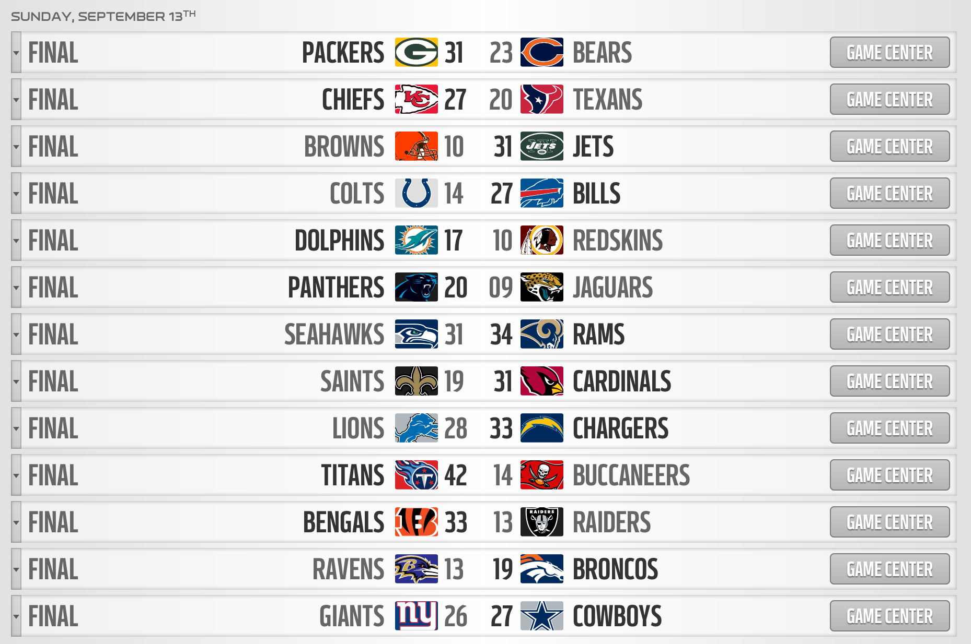
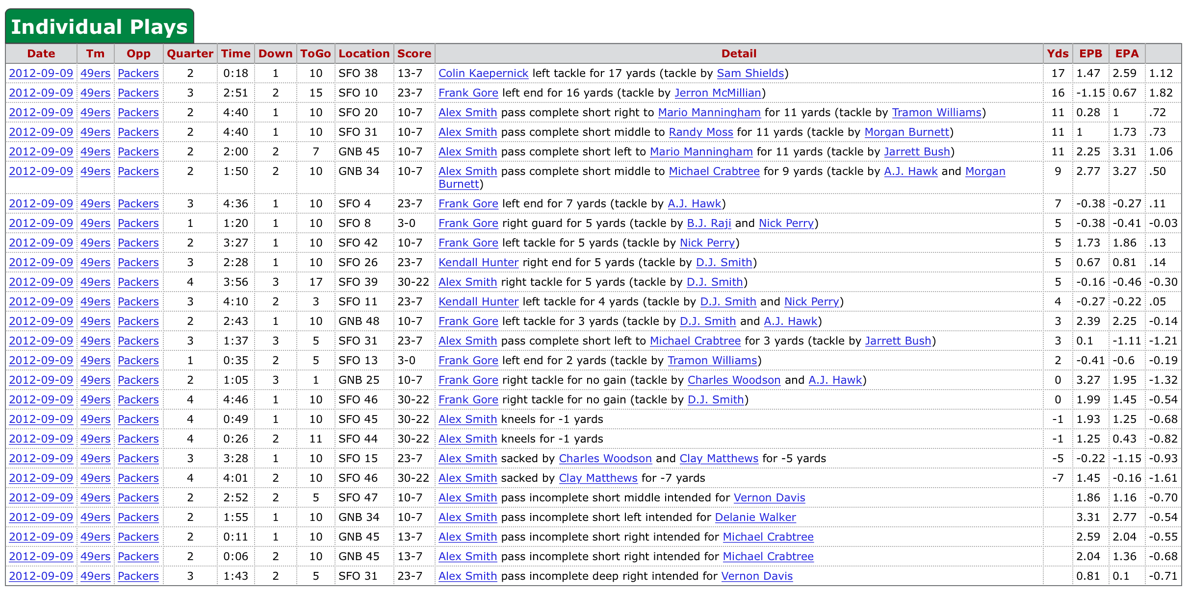
SOURCES
Notes:
So this is where we got our data. Here we have a screengrab from pro-football-reference.com, this is a website which gives information on all plays on a match by match basis in this format. As each page showed a maximum of 500 rows, we used python to generate nearly 4000 URL’s containing different queries, which we then wrote to a text file and used WGET to download the data ready for parsing into a CSV. Using regular expressions on the detail field allowed us to split it up into separate useful columns for analysis.
The schedule came from NFL.com, the structure here was challenging as it wasn’t already in table form, although the underlying HTML contained some potentially valuable information such as venue, and unique game ID’s which come in handy later. The end result after parsing was 4 csv files containing all our data which needed to be imported into postgres.

Slide 7
STRUCTURE
SCHEDULE
GAME_ID | DATE | HOME_TEAM | AWAY_TEAM | OTHER VARs
GAME_ID
GAME_ID
GAME_ID
PASSES
DATE | OFF_TEAM | DEF_TEAM | OTHER VARs
RUSHES
DATE | OFF_TEAM | DEF_TEAM | OTHER VARs
FIELD GOALS
DATE | OFF_TEAM | DEF_TEAM | OTHER VARs
Notes:
This is a quick overview of our postgres database structure. So first of all we have our schedule table, which as we mentioned previously has a already has a unique ID. We added this unique ID to our 3 play tables by doing a join based on the date, and matching up the offending team with one of the home or away teams.

Slide 8
FINDINGS
Most prolific passers since 1998
SELECT passer, COUNT(passer) AS total FROM nfl.passes
GROUP BY passer ORDER BY total DESC
Passer | Total
Peyton Manning | 9134
Drew Brees | 7530
Tom Brady | 7273
Brett Favre | 7116
Eli Manning | 5700
Donovan McNabb | 5492
Kerry Collins | 5161
Matt Hasselbeck | 5116
Ben Roethlisberger | 5072
Carson Palmer | 4981

